Slide 1
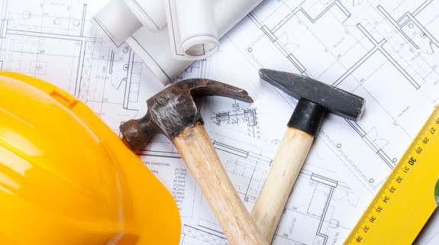
Nehemiah
Building Walls & Restoring Lives
Session 7: Nation Building

Slide 2
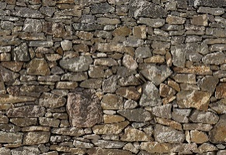
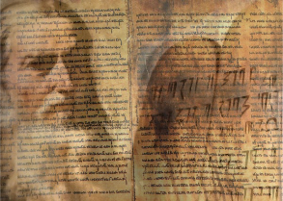
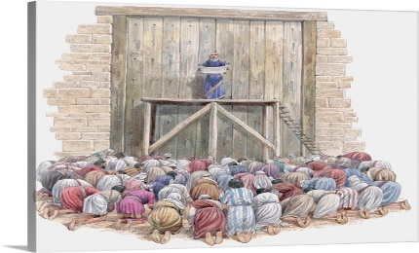
Nehemiah: The story so far …
He responds to news of the state of the people in Israel
He initiates work on rebuilding the walls
He presses through opposition from outside and within
He deals with justified complaints from among the people
He releases Ezra to restore the Law & Celebrations
He ensures the people understand the Law
Nehemiah
Building Walls & Restoring Lives

Slide 3
What was the call of God on Nehemiah’s life?
Nehemiah
Building Walls & Restoring Lives

Slide 4
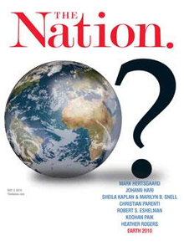
IMHO …
To rebuild the nation of Israel
Nehemiah
Building Walls & Restoring Lives

Slide 5
The prerequisites for a nation are
National Security and shelter
Food and water
Livelihoods
A legal system
A religious/worship system
So I think Nehemiah has been taking the people through a national rebuilding programme.
I also think the basis for this would have been the prophecies before and during the exile.
Nehemiah
Building Walls & Restoring Lives

Slide 6
In that context …
Let’s read a chunk of Nehemiah 9 and then draw out some key points for us …
Nehemiah
Building Walls & Restoring Lives

Slide 7
Nehemiah 9
Verses 26 -37
Please note the whole chapter is excellent, I have chosen this bit for the sake of time
Nehemiah
Building Walls & Restoring Lives

Slide 8
I wonder whether your life feels like the rollercoaster ride experience just like the people of Israel?
Nehemiah
Building Walls & Restoring Lives

Slide 9
Verse 31:
“But in your great mercy You did not put an end to them or abandon them, for You are a gracious and merciful God.”
Nehemiah
Building Walls & Restoring Lives

Slide 10
The revelation of 8 aspects of God’s character in the midst of difficulties:
Eternal
Powerful
Faithful
Just
Loving
Merciful
Generous
Patient
Reflection (Philippians 4:8): “Whatsoever things are … reflect on these things”
Nehemiah
Building Walls & Restoring Lives

